Slide 1
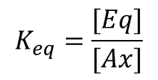
1,3 diaxial repulsions
CH₂ and X anti (antiperiplanar)
CH₂ and X gauche
$$K_{eq}=\frac{[Eq]}{[Ax]}$$
X | K_{eq} | ΔE | % eq
H | 1 | 0 | 50
Me | 19 | 7.3 | 95
Et | 20 | 7.5 | 95
i-pr | 42 | 9.3 | 98
t-but | >3000 | >20 | >99.9
OMe | 2.7 | 2.5 | 73
Ph | 110 | 11.7 | 99

