Slide 1
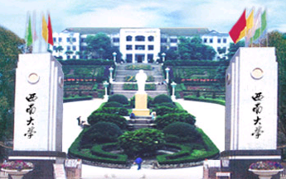


Summer Science Research Exchange Program
Henry Jakubowski, Ph.D
Professor, Chemistry Department.
College of Saint Benedict/Saint John’s University
St. Joseph/Collegeville, MN USA

Slide 2
FIRST TWO SUMMER EXCHANGE PROGRAMS
Summer 2006
Summer 2007
8 students:
4 biochemistry/chemistry
2 biology
2 physics
9 students:
4 biochemistry/chemistry
2 biology
1 physics
1 mathematics
1 psychology
Traveled from CSB/SJU on May 17 to Beijing
Toured Beijing for 3 days
Traveled to SWU where the partnered with an undergraduate student with the same major and worked in a lab for six weeks..

Slide 3
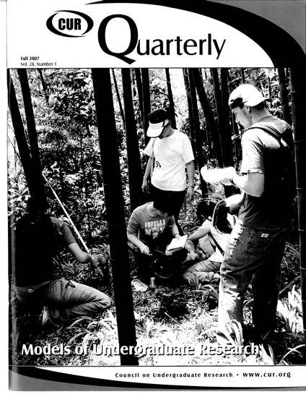
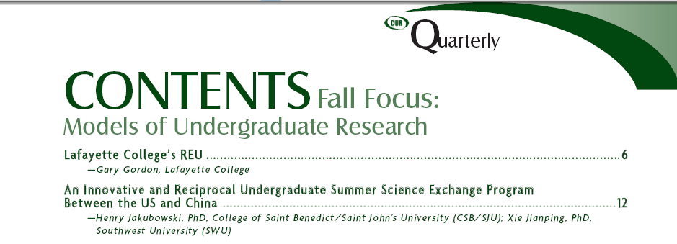
September, 2007

Slide 4
Selection of Projects and Professor Pairs
unrelated
Students work on projects that are … | Comments
1. completely unrelated and in different disciplines/subdisciplines | This is not ideal. A student interested in and doing field biology at one site might not have the skills or interest in doing molecular genetics at the other site.
2. completely unrelated but in the same general field of interest | This represents the nature of many of the projects in Summer 2006. These kinds of projects work well with the realization the students will not make as much progress on each six week projects as they would on a ten week project at one site.
3. in different fields but related in an interdisciplinary project | An interdisciplinary project with a math student working on a biological problem, for instance, would work well.
4. related and in the same field of interest (as defined by topic or experimental techniques). | This would be more ideal than separate unrelated projects and could lead to longer-term collaboration between faculty pairs. Hence projects involving expression of a mammalian protein in yeast at one site and in bacteria at the other could lead to collaborations between faculty pairs.
5. the same or different parts of the same research project at both sites | This would be difficult to develop in the short run, given distance, language barriers, and lack of an established relationship between faculty pairs. It doesn’t happen often even between members of the same department or between different departments. If such a real collaboration between faculty pairs could develop, it would be ideal and have maximal benefits for faculty and students.
related

Slide 5
Biology Department (past participants in red)
Field Biology/Ecology/Classical Genetics:
Dr. Gordon Brown: Terrestrial plant ecology, ecology and evolution of interactions between plants and herbivores, Web site
* Dr. Philip Chu: ornithology, systematics, Web site
Dr. Larry Davis: geology, paleontology,Web site
*Dr. William Lamberts: aquatic ecology, phycology, Web site (next year’s director)
Dr. Jeanne Marie Lust OSB: amphibian deformities, hematology, Web site
Dr. James Poff: entomology, behavioral ecology of social wasps, Web site
Dr. Charles Rodell: ecological genetics, evolution of sexual reproduction, Web site
Dr. Steven Saupe: plant taxonomy, secondary metabolism of plants and fungi, Web site
Dr. Shawn Thomas: animal behavior and sociobiology using evolutionary theory to test hypotheses regarding mate choice and sexual selection, Web site
Dr. Marcus Webster: physiological ecology, energetics of birds, Web site
Cell/Molecular/Biochemistry
*Dr. Barb May: immunology, microbiology, cell and molecular biology, Web site
Dr. Manuel Campos: signal transduction in cells and its relation to disease, Web site
Dr. Ellen Jensen: virology, biology of fungi, immunology, Web site
Dr. David Mitchell: protein structure, biochemistry, Web site
Dr. Michael Reagan: molecular biology, DNA repair mechanisms, Web site
Dr. Elizabeth Wurdak: biology of rotifers, histology, cell biology, Web site

Slide 6
Chemistry Department – Research Active
New Hire Fall 07- Bioanalytical Chemistry, Web site
Graham, Kate – Organic chemistry. isolation and characterization of biologically active compounds, Web site
Jakubowski, Henry - Biocehmisry.. Study of low molecular weight protein phosphatases using site specific mutagenesis and fluorescence spectroscopy; applications of fluorescence and molecular dynamics to study biological transitions, Web site
Johnson, Brian - Inorganic chemistry. Synthesis of Model Compounds for the Trinuclear site in Multicopper Oxidases, Web site
Jones, T. Nicholas - Organic chemistry. Synthesis of small molecules; synthetic methodology development; design and preparation of copper enzyme model systems;,Web site
McIntee, Ed – Organic chemistry., Antibacterial pro-drug synthesis, synthesis of low molecular weight protein tyrosine phosphates inhibitors. Web site
Rioux, Frank – Quantum chemistry. Ab initio quantum mechanical calculations on titanium cage compounds (azatitanatranes) using the electronic structure programs GAMESS and SPARTAN., Web site
Ross, Michael – Analytical chemistry. Pharmaceuticals and Personal Care Products in Surface Water, Web site
Schaller, Chris - Organometallic chemistry, New Catalysts or Initiators for Polymerization of Lactide. Web site

Slide 7
Physics Department – Past Participants
Dean Langley– Optics.
Jim Crumley - study of the plasma environment which fills the space between the planets and the Sun in the solar system. This research involves analysis of data from spacecraft and computer simulations of the phenomena seen in space. Webpage.
Psychology Department – Past Participant
Linda Tennison –Perception, Behavioral Neuroscience, Animal Learning and Behavior. Cross Cultural Exploration: Body Image Concerning Height and Cross Cultural Exploration: Stigma of Mental Illness Webpage
Math Department –
Tom Sibley – finite geometric spaces with at least transitive symmetry groups. Web Page.
Jennifer Galovich - enumerative and algebraic combinatorics. Mahonian statistics and various analogs; combinatorial biology, especially combinatorial aspects of RNA secondary structure as well as phylogenetics and graph theory. Web Page.
Computer Science –

Slide 8
Time Table
December 1, 2007 – January 7, 2008: Faculty Pair Selection
CSB/SJU faculty from Biology, (Bio)Chemistry, Math, Physics, Psychology, and Computer science will send research descriptions to the Foreign Affairs Office at SWU. They will send them to SWU Departments for faculty to review. Faculty pairs will communicate by email and agree to participate in the program and develop projects. Most important will be the lab techniques used in SWU lab, not name of Dept. (CSB/SJU winter break: Dec 21-Jan 13; SWU winter vacation: January 7- March 2).
January 14-28, 2008: CSB/SJU student complete and submit applications
February 11, 2008: CSB/SJU students will be accepted and notified. They will immediately apply for passports and visas.
March 3-14, 2008: SWU students will apply for the program.
March 28: SWU students will be accepted and notified. They will immediately apply for passports and visas.
May 16: CSB/SJU students will leave with Dr. Bill Lamberts, arriving for a long weekend (Friday – Monday AM for sightseeing in Beijing, Shanghai, or other yet to be determined site.
May 19: CSB/SJU students arrive at SWU and start 6 week program.
June 30: CSB/SJU and SWU students leave for CSB/SJU
August 8, 2008: Program Ends
August 9,10: SWU students return home.

Slide 9
SWU Student Selection
Students will be select based on two main criteria:
Scientific skills, experience, and long range goals (such as the desire to attend graduate school and/or pursue a science career). Their SWU faculty advisor will select students based on their scientific skills
English proficiency: The Faculty advisor and Waiban will interview the candidates to determine their English skills. Students do NOT have to take a written exam.
Science skills and interests are more important than English skills

Slide 10
CSB/SJU Student Selection
Students will be select based on following criteria:
Scientific skills, experience, and long range goals (such as the desire to attend graduate school and/or pursue a science career). Their CSB/SJU faculty advisor will select students based on these traits and student interest and commitment to the research project and program.
Personal Traits required for living in China: The Program Director will interview the candidates to determine if they possess traits (interest, flexibility, resourcefulness, friendliness, openness, independence, respectfulness, etc) to work, live, and make friends in China.
Willingness to Mentor SWU Students at CSB/SJU: This is highly important especially given the rural nature of our campuses. CSB/SJU must agree to participate in all social activities with the SWU students when they return to the US.

Slide 11
ROLE OF THE SWU FACULTY ADVISORS FOR CSB/SJU STUDENTS
Partner CSB/SJU and SWU faculty should discuss (by email) the research projects and the expected level of supervision of the students and agree to both.
The SWU faculty advisor should meet with the students at a minimum of 2 hours a week, and if necessary more in the very first week of the project.
In addition, the SWU faculty advisor would designate a graduate student as a primary co-advisor who understands the project and who would be assigned to guide the students activities in the research project on a daily basis.
These guidelines are similar to those that the CSB/SJU students experience when they do summer research at major research centers/universities in the USA (such as the University of Minnesota, the National Institutes of Health, etc).
ROLE OF THE CSB/SU FACULTY ADVISORS FOR SWU STUDENTS
Partner CSB/SJU and SWU faculty should discuss (by email) the research projects and the expected level of supervision of the students and agree to both.
The CSB/SJU faculty advisor should meet with the students at a minimum of 4-5 hours (since there are no post-graduate students to help students) a week, and if necessary more in the very first weeks of the project.

Slide 12
Participants in the Summer 06 program have:
been accepted to graduate school at Stanford University, Michigan Tech (China students) and Fudan University (in the top 3 in China)
transferred to CSB from SWU
Participants in the Summer 07 program have:
been accepted to Fudan University, uncertain of CSB/SJU students.

Slide 13
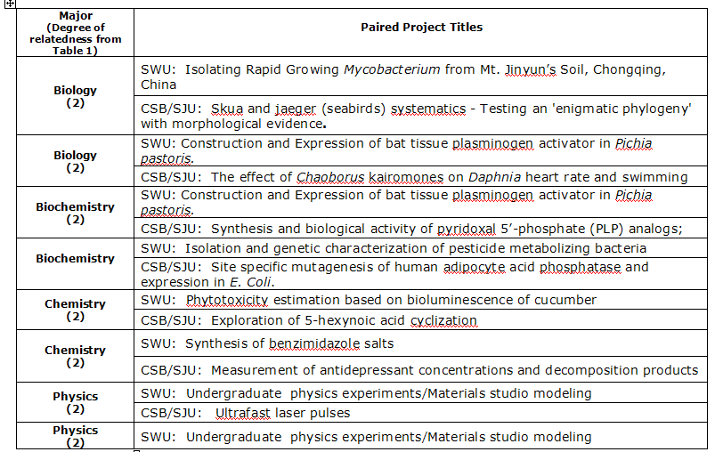
Summer 2006 Projects

Slide 14
Initial Project Pairs , Summer 07
Biology | Barb May (Microbial genomics, pathogenesis of infection) bmay@csbsju.edu | Do certain strains of Mycobacterium tuberculosis like the brain?
Microbiology Biochemistry & MolecularBiology | Xie Jianping (Molecule Microbiology & Functional Genomics) georgex@swu.edu.cn | Persistence or dormancy / reactivation mechanisms on the Mycobacterium tuberculosis based on non-pathogen model of Mycobacterium smegmatis
Biology | Bill Lamberts (Aquatic Ecology,) wlamberts@csbsju.edu | Factors affecting predator avoidance by Daphnia pulex.
Microbiology Biochemistry & MolecularBiology | Xie Jianping (Molecule Microbiology & Functional Genomics) georgex@swu.edu.cn | Systems biology and systems biotechnology on the microbial hydrogen production
Bio/Chem (Biochem) | Henry Jakubowski (Biochemistry) hjakubowski@csbsju.edu | Purification and characterization of low molecular protein tyrosyl phosphotase mutants
Biochemistry Molecular Biology | Liu Yan (Proteome and Enzymology) email: Liuyan@swu.edu.cn | Proteome engineering of Interleukin-2 (IL-2)
Chemistry | Ed McIntee (Medicinal) definite) emcintee@csbsju.edu | Development of potenital inhibitors for Low Molecular Weight Protein Tyrosine Phosphatase (LMW PTP)
Organic Chemistry | Zhou Chenghe (Bio-organic & Medical Chemistry) email: zhouch@swu.edu.cn | Synthesis and biological activities of novel azole derivatives as drugs
Chemistry | Michael Ross (Analytical) mross@csbsju.edu | Measurement of Antidepressant Concentrations and Decomposition Products in East Gemini Lake
Analytical Chemistry | Huang Chengzhi (Analytical Chemistry) email: chengzhi@swu.edu.cn | Spectral Analysis (This project was changed)
Chemistry | Nicholas Jones (Organic) tjones@csbsju.edu | Alkynoic Acid cyclization studies
Organic & Medicinal Chemistry | He Yanhong (Organic Chemistry) email: heyh@swu.edu.cn | Synthesis of bioactive natural products and their analogues
Mathematics | Tom Sibley tsibley@csbsju.edu | Constructing Homogeneous Spaces
Algebra Application of Group Theory | Zhou Jiazu (Pure Mathematics & Applied Mathematics) email: zhoujz@swu.edu.cn | Structure of a finite group under restrictions on the number of largest elements or the set of maximal abelian subgroups (This project was changed)

