Slide 1
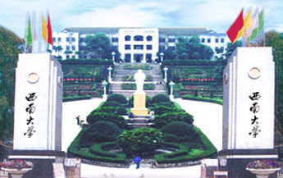


Summer Research Exchange Program
Henry Jakubowski, Ph.D
Professor, Chemistry Department.
College of Saint Benedict/Saint John’s University
St. Joseph/Collegeville, MN USA

Slide 2
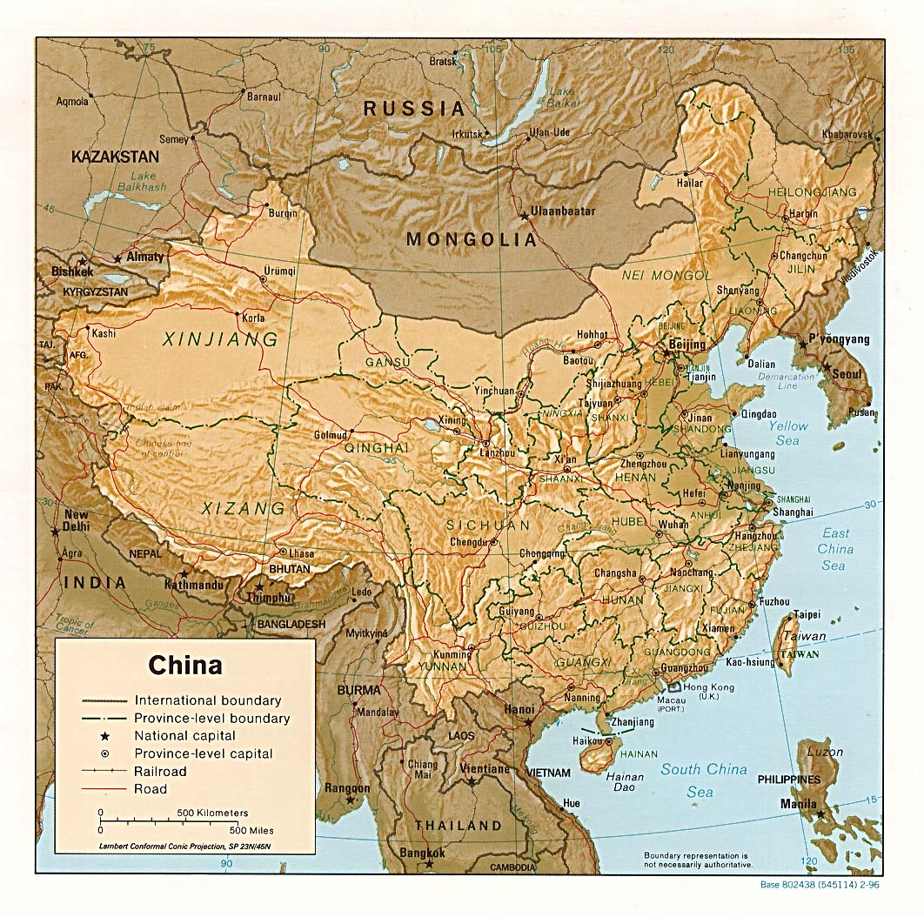
Beijing
Beibei
Chongqing

Slide 3
FIRST 3 SUMMER EXCHANGE PROGRAMS
Summer 2006
Summer 2007
Summer 2008
8 students:
4 biochemistry/chemistry
2 biology
2 physics
9 students:
4 biochemistry/chemistry
2 biology
1 physics
1 mathematics
1 psychology
8 students:
3 biochemistry/chemistry
2 biology
2 physics
1 computer science
Traveled from CSB/SJU mid May to Beijing
Toured Beijing for 3 days
Traveled to SWU where the partnered with an undergraduate student with the same major and worked in a lab for six weeks..

Slide 4

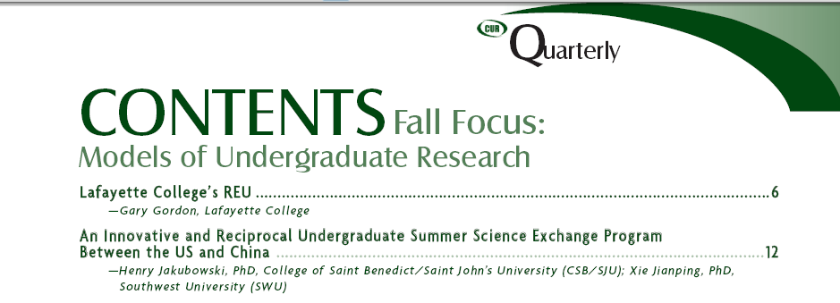
September, 2007

Slide 5
Making the Program Better - Faculty Pairs before Student Pairs
unrelated
Students work on projects that are … | Comments
1. completely unrelated and in different disciplines/subdisciplines | This is not ideal. A student interested in and doing field biology at one site might not have the skills or interest in doing molecular genetics at the other site.
2. completely unrelated but in the same general field of interest | This represents the nature of many of the projects in Summer 2006. These kinds of projects work well with the realization the students will not make as much progress on each six week projects as they would on a ten week project at one site.
3. in different fields but related in an interdisciplinary project | An interdisciplinary project with a math student working on a biological problem, for instance, would work well.
4. related and in the same field of interest (as defined by topic or experimental techniques). | This would be more ideal than separate unrelated projects and could lead to longer-term collaboration between faculty pairs. Hence projects involving expression of a mammalian protein in yeast at one site and in bacteria at the other could lead to collaborations between faculty pairs.
5. the same or different parts of the same research project at both sites | This would be difficult to develop in the short run, given distance, language barriers, and lack of an established relationship between faculty pairs. It doesn’t happen often even between members of the same department or between different departments. If such a real collaboration between faculty pairs could develop, it would be ideal and have maximal benefits for faculty and students.
related

Slide 6
SELECTION PROCESS FOR FACULTY AND STUDENTS
Dr. Henry Jakubowski will send preliminary descriptions of research project(s) from CSB/SJU faculty who are potentially interested in working with a student pair in summer 09 to SWU by Tuesday, November 25, 2008.
Dr Jim Schnepf, Computer Science and present CSB/SJU study abroad director at SWU, will coordinate dialog with work with the Foreign Affairs Department and interested faculty at SWU until he leaves (around Dec 10).
SWU Faculty will decide if they would like to participate, and then initiate an email conversation in December and early January with their potential CSB/SJU faculty partner about possible paired projects. At the end of this email conversation, the faculty would decide about their participation. (Note SWU is on winter break from around 1/1-3/1/09.
CSB/SJU students apply to the program from January 12 (start of spring semester) to January 26. 2009. Selections will be finished by February 9. SWU students will apply beginning around March, 2009.

Slide 7
SWU Student Selection
Students will be select based on two main criteria:
Scientific skills, experience, and long range goals (such as the desire to attend graduate school and/or pursue a science career). Their SWU faculty advisor will select students based on their scientific skills
English proficiency: The Faculty advisor and Waiban will interview the candidates to determine their English skills. Students do NOT have to take a written exam.
Science skills and interests are more important than English skills

Slide 8
CSB/SJU Student Selection
Students will be select based on following criteria:
Scientific skills, experience, and long range goals (such as the desire to attend graduate school and/or pursue a science career). Their CSB/SJU faculty advisor will select students based on these traits and student interest and commitment to the research project and program.
Personal Traits required for living in China: The Program Director will interview the candidates to determine if they possess traits (interest, flexibility, resourcefulness, friendliness, openness, independence, respectfulness, etc) to work, live, and make friends in China.
Willingness to Mentor SWU Students at CSB/SJU: This is highly important especially given the rural nature of our campuses. CSB/SJU must agree to participate in all social activities with the SWU students when they return to the US.

Slide 9
ROLE OF THE SWU FACULTY ADVISORS FOR CSB/SJU STUDENTS
Partner CSB/SJU and SWU faculty should discuss (by email) the research projects and the expected level of supervision of the students and agree to both.
The SWU faculty advisor should meet with the students at a minimum of 2 hours a week, and if necessary more in the very first week of the project.
In addition, the SWU faculty advisor would designate a graduate student as a primary co-advisor who understands the project and who would be assigned to guide the students activities in the research project on a daily basis.
These guidelines are similar to those that the CSB/SJU students experience when they do summer research at major research centers/universities in the USA (such as the University of Minnesota, the National Institutes of Health, etc).
ROLE OF THE CSB/SU FACULTY ADVISORS FOR SWU STUDENTS
Partner CSB/SJU and SWU faculty should discuss (by email) the research projects and the expected level of supervision of the students and agree to both.
The CSB/SJU faculty advisor should meet with the students at a minimum of 4-5 hours (since there are no post-graduate students to help students) a week, and if necessary more in the very first weeks of the project.

Slide 10
Collecting soil samples on Jinyun Mountain

Slide 11
A SJU Chemistry Students with his Chinese Lab Group

Slide 12
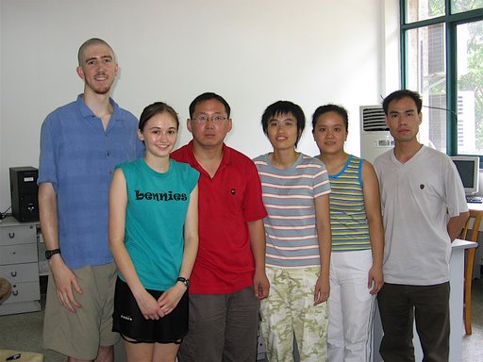
Graduate student, Stanford University
Graduate student,
SWU University
Transfer student, CSB
The Physics Pairs and Faculty Mentor at SWU

Slide 13
Graduate student, Fudan University
Graduate student, Michigan Tech. University
Graduate student,
Southern Methodist University
Texas
Medical School, UC Riverside, California
The China Students and Professor Xie in St. Cloud

Slide 14
Medical School California
Optometry School California
A CSB/SWU Pair at Lake Sag

Slide 15
Medical School, Minnesota USA
Graduate School, Texas USA
A CSB/SWU Biology Pair at SJU

Slide 16
The Final Banquet at the President’s House - CSB

Slide 17
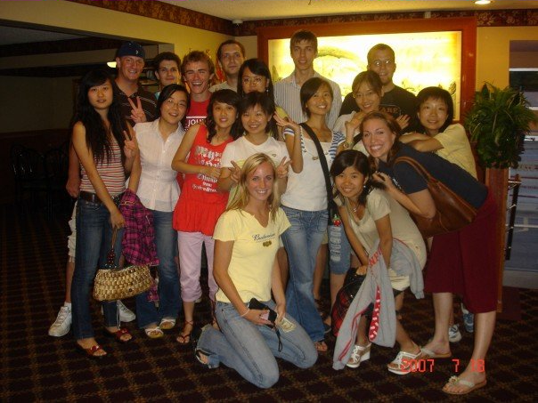
Summer 2007 Participants

Slide 18
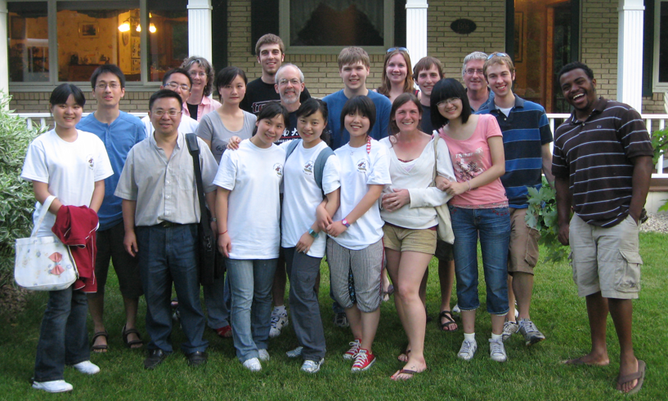
Summer 2008 Participants

